Slide 1
Regular Meeting
2020/06/15
Phd Candidate
Yang Linhan

Slide 2
Paper Review
Retrographic sensing for the measurement of surface texture and shape
Physical Environment
Contact
Sensors
?
Inference
[1] Johnson M K, Adelson E H. Retrographic sensing for the measurement of surface texture and shape[C]//2009 IEEE Conference on Computer Vision and Pattern Recognition. IEEE, 2009: 1070-1077.

Slide 3
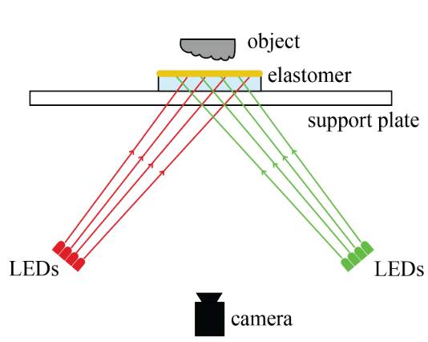
Paper Review
Retrographic sensing for the measurement of surface texture and shape
Photometric stereo algorithm
Different
illumination
Objects
Datasets
Lookup tables
Mapping from (x,y) to intensity
Physical Environment
Contact
Sensors
Shape of objects
Photometric
Stereo
Inference
Reconstruct the surface
[1] Johnson M K, Adelson E H. Retrographic sensing for the measurement of surface texture and shape[C]//2009 IEEE Conference on Computer Vision and Pattern Recognition. IEEE, 2009: 1070-1077.
[2] Yuan W, Dong S, Adelson E H. Gelsight: High-resolution robot tactile sensors for estimating geometry and force[J]. Sensors, 2017, 17(12): 2762.

Slide 4
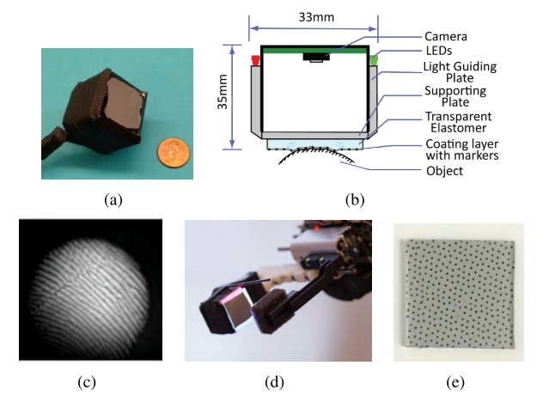
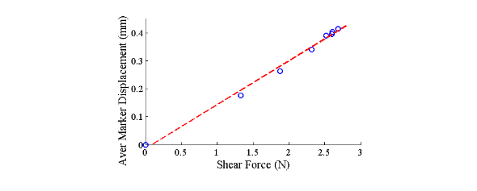
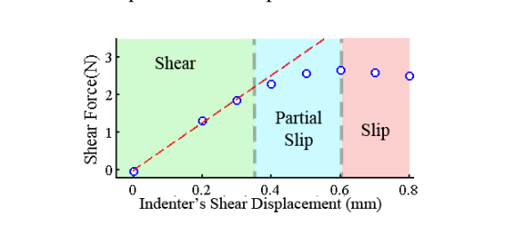
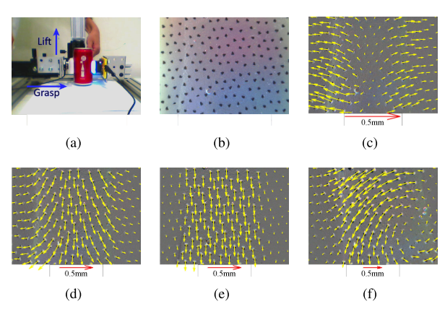
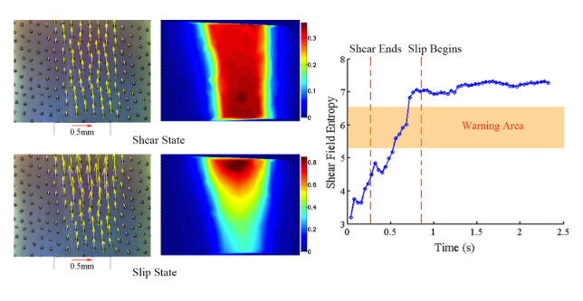
Paper Review
Measurement of Shear and Slip with a GelSight Tactile Sensor
Relationship between Markers Displacement and Shear Force
Physical Environment
Contact
Sensors
Shape of objects+
Motion of markers
Photometric
Stereo
Inference
Shear Force+
Shear Force Entropy
Shear Force Entropy
[1] Yuan W, Li R, Srinivasan M A, et al. Measurement of shear and slip with a GelSight tactile sensor[C]//2015 IEEE International Conference on Robotics and Automation (ICRA). IEEE, 2015: 304-311.

Slide 5
Paper Review
GelSight: High-Resolution Robot Tactile Sensors for Estimating Geometry and Force
Application
Physical Environment
Contact
Sensors
Shape of objects+
Motion of markers
Photometric
Stereo
Inference
Texture+
Shear Force+
Entropy
[1] Yuan W, Dong S, Adelson E H. Gelsight: High-resolution robot tactile sensors for estimating geometry and force[J]. Sensors, 2017, 17(12): 2762.

Slide 6
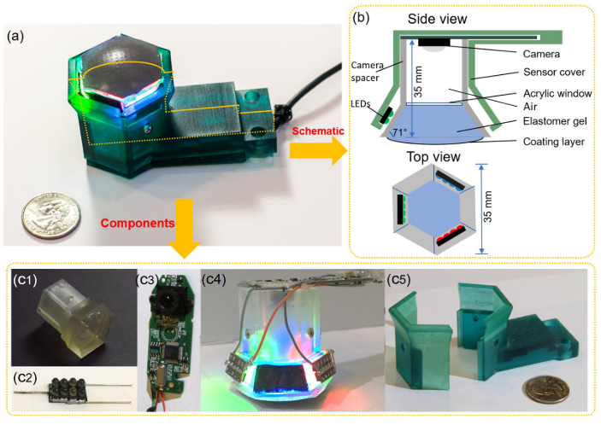
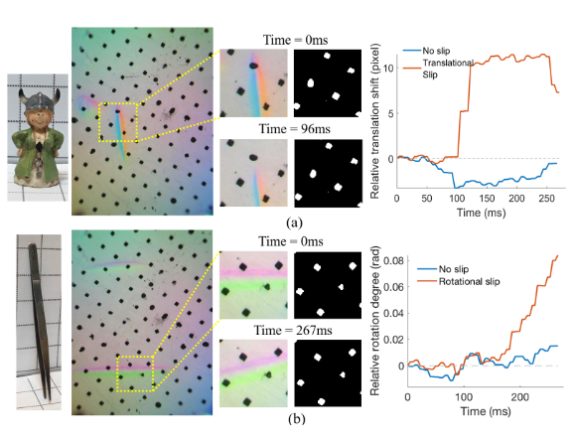
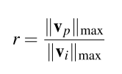
Paper Review
Improved GelSight Tactile Sensor for Measuring Geometry and Slip
Basic idea: peripheral contact area has less displacement compared to the central area.
Locate the peripheral areas and centeral area
pick the moving vector with the largest norm
Calculate r. If r is larger than a threshold, we consider the slip is occurring
a Lambertian surface instead of a semi-specular surface
Physical Environment
Contact
Sensors
Shape of objects+
Motion of markers
Photometric
Stereo
Inference
Texture+
Shear Force+
Entropy
Slip Detection
Measuring the motion of markers
Slip Detection?
[1] Dong S, Yuan W, Adelson E H. Improved gelsight tactile sensor for measuring geometry and slip[C]//2017 IEEE/RSJ International Conference on Intelligent Robots and Systems (IROS). IEEE, 2017: 137-144.

Slide 7
Paper Review
Improved GelSight Tactile Sensor for Measuring Geometry and Slip
Basic idea: peripheral contact area has less displacement compared to the central area.
Locate the peripheral areas and centeral area
pick the moving vector with the largest norm
Calculate r. If r is larger than a threshold, we consider the slip is occurring
a Lambertian surface instead of a semi-specular surface
Physical Environment
Contact
Sensors
Shape of objects+
Motion of markers
Photometric
Stereo
Inference
Texture+
Shear Force+
Entropy
Slip Detection
Measuring the motion of markers
Regrasp
Inceasing Gripping Force
If Slip Occurs
[1] Dong S, Yuan W, Adelson E H. Improved gelsight tactile sensor for measuring geometry and slip[C]//2017 IEEE/RSJ International Conference on Intelligent Robots and Systems (IROS). IEEE, 2017: 137-144.

Slide 8
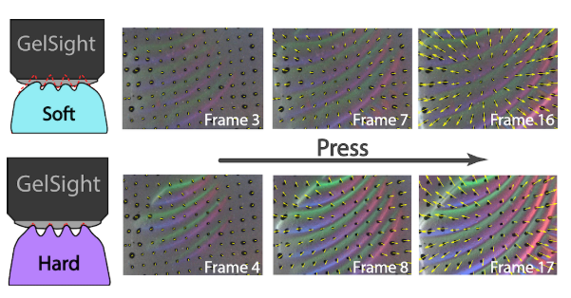
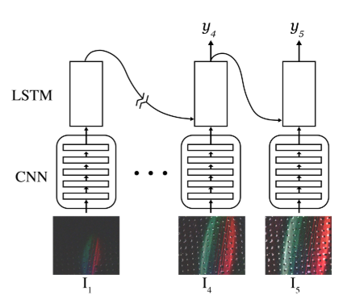
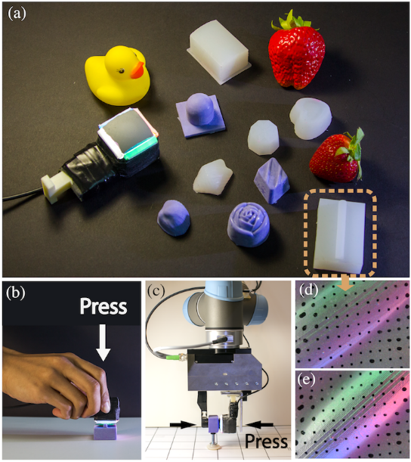
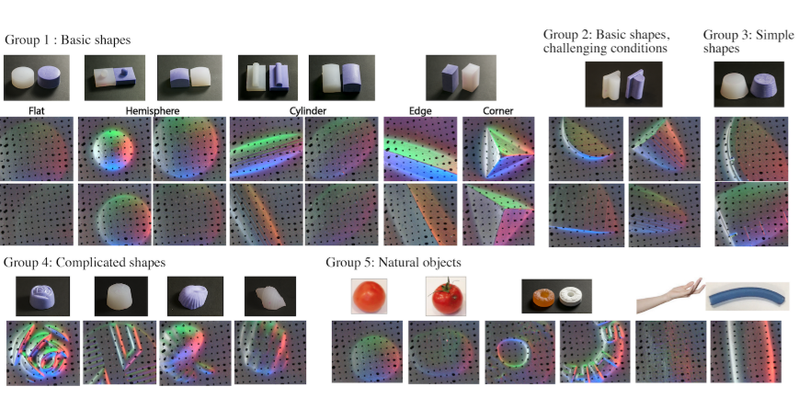
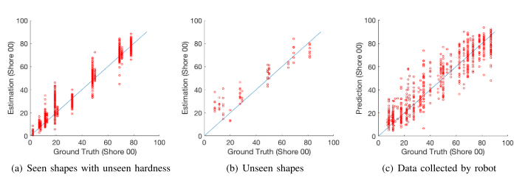
Paper Review
Shape-independent Hardness Estimation Using Deep Learning and a GelSight Tactile Sensor
Physical Environment
Contact
Sensors
Shape of objects+
Motion of markers
Photometric
Stereo
Inference
Texture
CNN
RNN
Hardness Estimation
[1] Yuan W, Zhu C, Owens A, et al. Shape-independent hardness estimation using deep learning and a gelsight tactile sensor[C]//2017 IEEE International Conference on Robotics and Automation (ICRA). IEEE, 2017: 951-958.

Slide 9
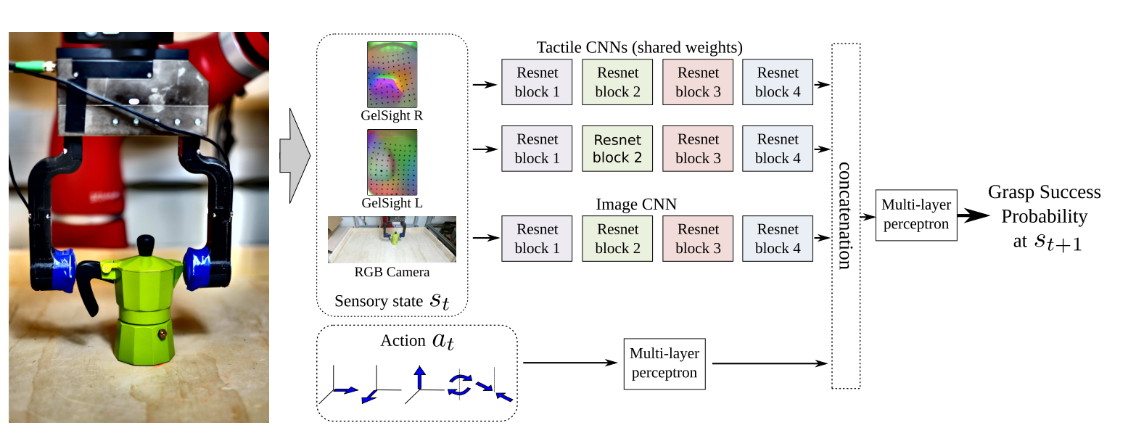
Paper Review
More Than a Feeling: Learning to Grasp and Regrasp using Vision and Touch
1. Randomly sample potential actions and predict the success probability using the learned model
2. Select the action with the highest success probability.
Physical Environment
Contact
Sensors
Tactile + Vision
Action-conditioned visuo-tactile model network architecture
Success Probability Estimation
Regrasp
Highest Success Probability
[1] Calandra R, Owens A, Jayaraman D, et al. More than a feeling: Learning to grasp and regrasp using vision and touch[J]. IEEE Robotics and Automation Letters, 2018, 3(4): 3300-3307.

Slide 10
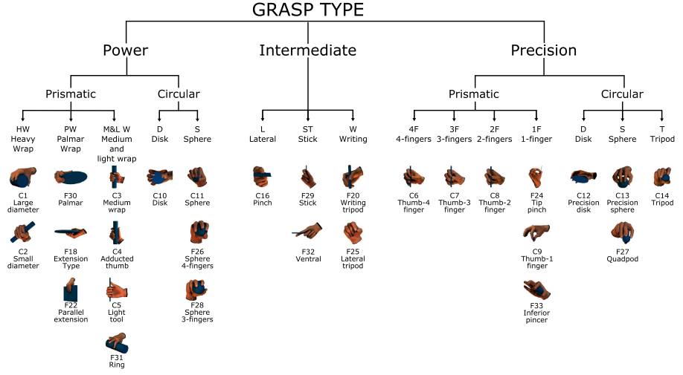
Paper Review
Is it real necessary to estimate the force during the exploration and manipulation?
Human doesn’t estimate force when grasping
Slip Detection
Measuring the motion of markers
Hardness Estimation
Regrasp

Slide 11
Paper Review
Explore the world with proprioception
CoRL-2020
Detection of slipper : contact point estimation
Regrasping: estimate the torque – grasping quality estimation
Hardness Estimation
Slipper Detection
Three Experiments based on Liu and He’s work.
Physical Environment
Contact
Sensors
Image of Finger
CNN
Inference
Contact Point
Regrasping
Hardness Estimation

Slide 12
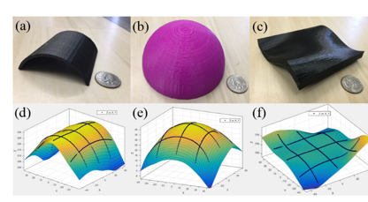
Paper Review
Explore the world with proprioception
Limitation
Only estimate contact position (low resolution and dependent on the objects)
Image processing: influenced by background
Possible Solutions (Long-term)
Construct the height map of contact surface – How ?
Special Markers – provide 3D information
Fibers – multi dimensional, FBG
[1] Xu L, Ge J, Patel J H, et al. Dual-layer orthogonal fiber Bragg grating mesh based soft sensor for 3-dimensional shape sensing[J]. Optics express, 2017, 25(20): 24727-24734
[2] . Yamaguchi A, Atkeson C G. Implementing tactile behaviors using fingervision[C]//2017 IEEE-RAS 17th International Conference on Humanoid Robotics (Humanoids). IEEE, 2017: 241-248.

